Slide 1
1.00 Apply procedures to set project requirements. (10%)

Slide 2
Digital Video
Moving images that have been captured, created, or edited electronically.
Digital video signals transmit information in the form of individual bits of data.
Analog (non-digital) video signals transmit information continuously in the form of a wave.

Slide 3
Streaming Video
Transmitting video files that can begin playing over the Internet as the remaining data is still being downloaded.
Creates little to no wait time to begin viewing the video file.
Example websites that use streaming video technology include: YouTube, Netflix, Vimeo, UStream, etc.

Slide 4
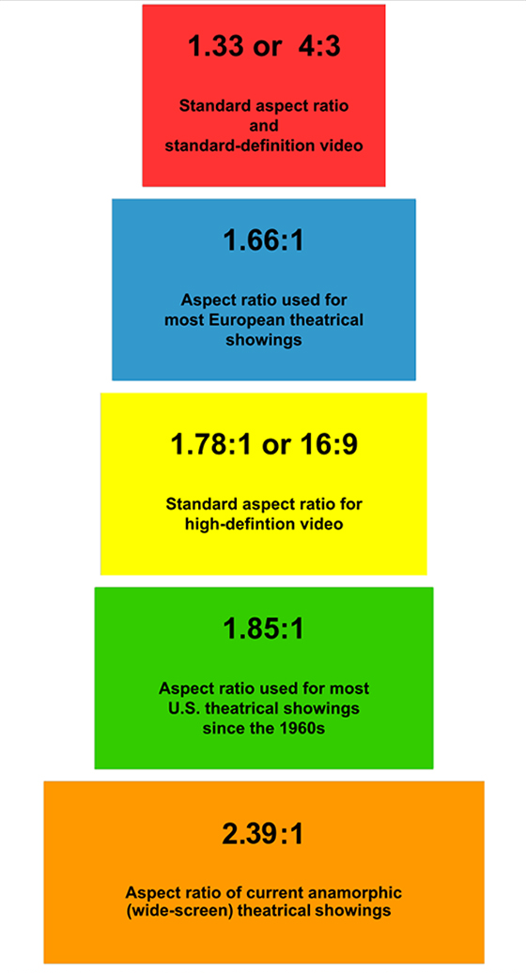
Characteristics of Digital Video
Aspect Ratio
Ratio of a video screen’s width and height dimension; common ratios are standard (4:3) and widescreen (16:9).
Frame Rate
Speed at which video frames appear on a screen; measured by frames per second (FPS).

Slide 5
Characteristics of Digital Video
Scanning Method
Method by which video picture appears on a screen (720p, 1080i, etc.).
Interlaced (I)
Displays half of the video picture at a time (odd lines, then even); alternates too quickly for human eye to notice.
Progressive (p)
Displays the entire video picture at all times; greatly reduces any flickering of picture; better quality image than interlaced.

Slide 6
Broadcasting Systems
National Television System Committee (NTSC)
Standard used in North America and most of South America. In NTSC, 30 frames are transmitted each second.
Phase Alternating Line (PAL)
Standard mostly used overseas. In PAL, 25 frames are transmitted each second.
Sequential Color with Memory (SECAM)
French and Asian broadcast television standard.

Slide 7
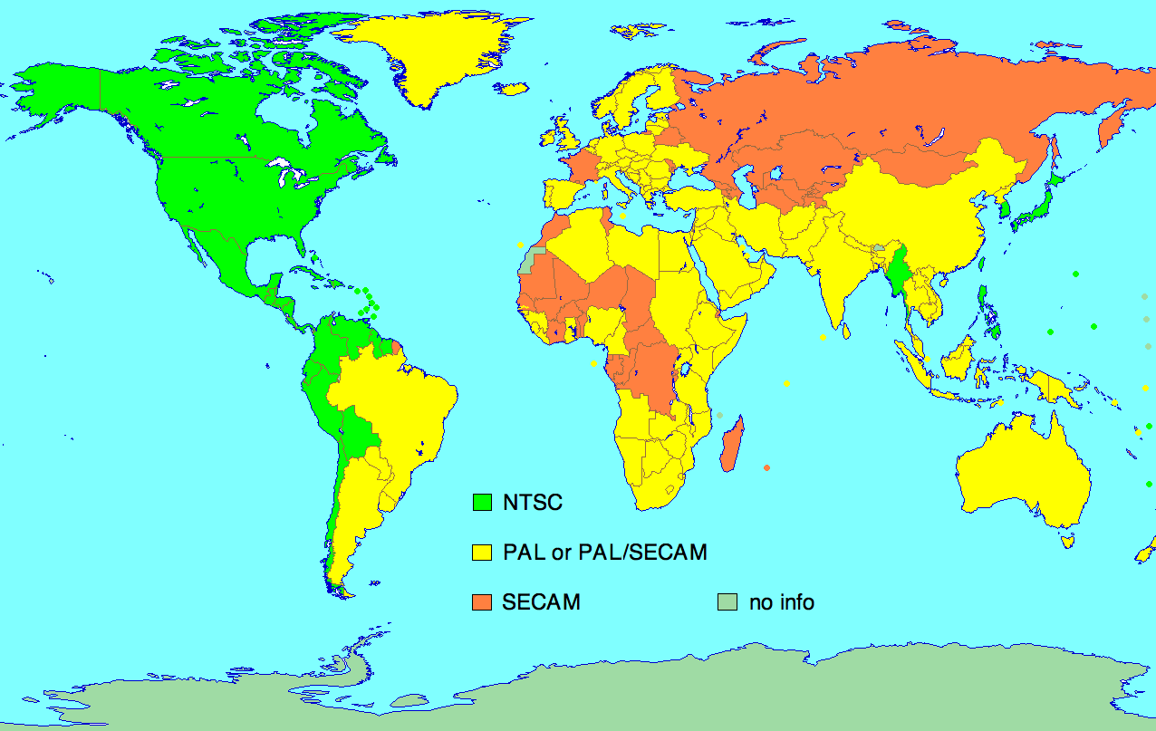
Broadcasting Systems

Slide 8
Project Management
Beginning a digital media project from scratch and carrying it through to its final completion takes a unified effort from all parties involved.
Creating a Project Plan helps the process move forward quickly and efficiently. It helps the team avoid:
mistakes
arguments
tension within the team
wasted time

Slide 9
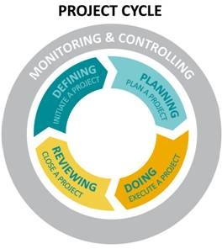
Project Management
Four stages in project management process:
Defining
Planning
Doing
Reviewing

Slide 10
Defining
Defining a project is the opportunity to establish its elements and boundaries, so that the size and shape of the project and its outcomes are all understood and agreed upon before beginning work.

Slide 11
Defining
Some of the questions addressed include:
What do you do first?
What should come next?
Who will complete each task?
What resources do you need?
How long will it take?
When will the project be finished?
How will we know we are done with the project?

Slide 12
Defining
Identify the following things:
Project objectives
Target audience
Goals
Sub-phases
Tasks
Resources
Budget
Schedule

Slide 13
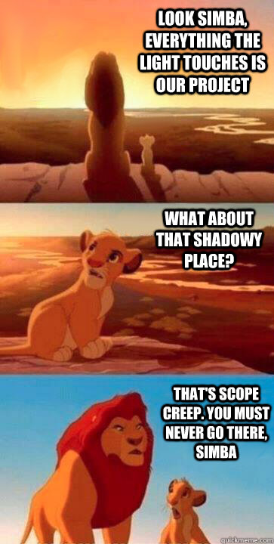
Defining: Project Scope
Scope Creep
Incremental expansion of the project scope.
Introducing features not originally planned.
Delays project and adds cost.

Slide 14
Defining: Flow Chart
Objective ____ or Task ____
Steps to complete
Write Materials on the sides.

Slide 15
Defining: Schedule

Slide 16
Planning
Planning is an important step because the amount of time and energy dedicated to planning will correlate directly to how well the project stays on schedule, on budget, and how well it meets its goals.
File requirements
File management
Color scheme
Typography
Logos/images created or located
Script/Storyboard/Mock Layout created

Slide 17
Doing
The core of the project is doing, the execution—the implementation of the plans. In order to accomplish their goals, members will be monitoring their work, collaborating with team members, assessing their progress, and revising their project plans as necessary.
Create needed project elements
Compile and edit project
Monitor schedule and task completion

Slide 18
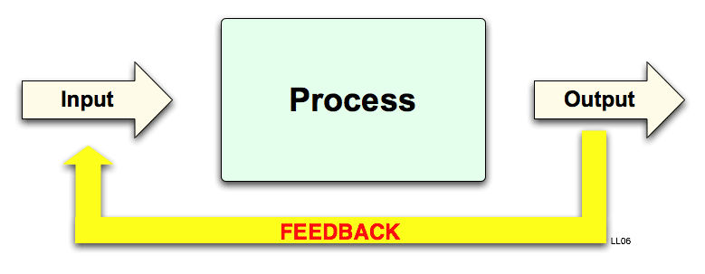
Reviewing
Reviewing is the opportunity to focus on the effectiveness of the team’s processes and the quality of the project deliverables. In this final stage, the focus is on assessing and celebrating the achievements of the entire project.
Preview proofs
Revise based on feedback
Optimize files
Publish in final format

Slide 19
Pre-Production
Meet with the client to create a project plan:
Determine the purpose of the video production.
Define a target audience.
Set overall goals of the video.
Agree on deadlines for phases of the project.
Create a budget for the production.
Decide what equipment will be necessary to create the video project.

Slide 20
Pre-Production
Script Writing
Script is needed to tell the actors (both on screen and for a voiceover) what to say and when. The script also gives direction to set lighting, sound effects, and other components of the project.
It is important to consider the following:
The overall goals of the video project.
The target audience of the project.
The accepted vernacular of the target audience.
The readers (performers) of the script.

Slide 21
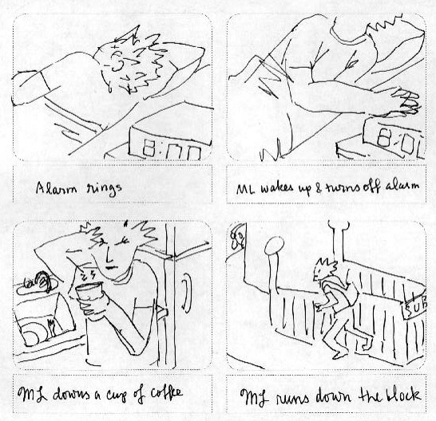
Pre-Production
Create the storyboard:
Sketch out a visual representation of each major scene or major phase of the video project.
Provide information about the audio sources, camera movements, and transitions.

Slide 22
Pre-Production
Create a shot list in the sequence of the storyboard for the camera operators.
Get any actors or other on-camera participants to sign a talent release document.
Gather and manage information and digital assets provided by the client.
Create a file-naming convention to assure proper organization and storage.
Save and organize files for easy and quick access.

Slide 23
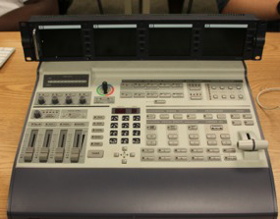
Pre-Production
Choose appropriate equipment:
Choose camera(s)
Choose microphone(s)
Choose cables
Other equipment (video mixer).
Mostly used for live video productions.
Accepts multiple camera sources and combines them into one production.
Can automatically add transitions and effects to the input sources.

Slide 24
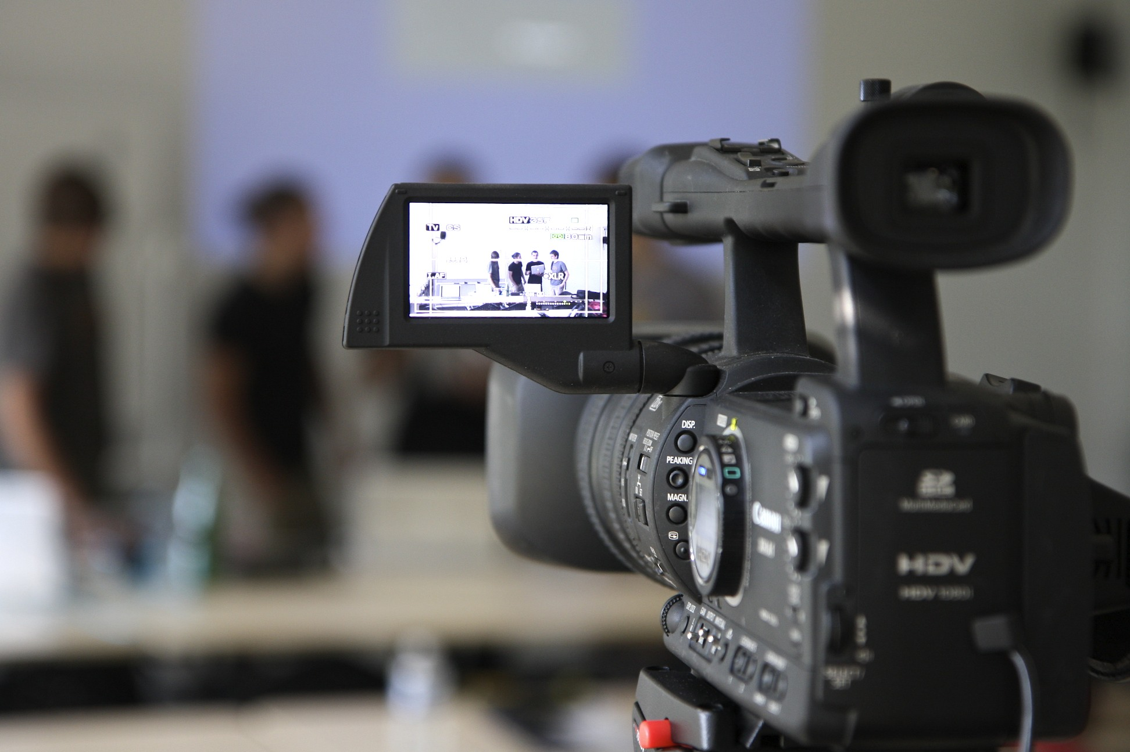
Production
In video production, the production phase consists only of recording footage with a camera.
NO editing!

Slide 25
Post-Production
Capture and name video footage.
Edit video footage to match project needs.
Apply special effects.
Add audio.
Add transitions.
Add titles.
Export final video to selected format.

Slide 26
Post-Production
Re-design the video production on client feedback (if necessary).
Render the video and re-export after addressing feedback.
Watch the exported video in its entirety to check for quality assurance.

Slide 27
Post-Production
Optimize based on specific client needs:
File Format Requirements
Video files also use codecs.
File Size Requirements
File Name Requirements

Slide 28
Legal Terms in Digital Media
Intellectual Property
Original creations of the mind that can be protected by law; literary and artistic works, designs, symbols, images, names, etc.
Copyright
The exclusive legal right to reproduce, publish, sell or distribute the expression of an intellectual property (literature, design, audio, video, etc.)

Slide 29
Legal Terms in Digital Media
Trademark
A mark (logo, symbol, word, phrase, etc.) legally registered or established by a company to represent a service or product; cannot be used without the permission of the owner.
Fair Use
A legal allowance of using a copyrighted material without permission from the owner, provided the circumstances are reasonable and do not make the material less profitable.

Slide 30
Creative Commons
A nonprofit organization that enables the sharing and use of creativity and knowledge through free legal tools.
Free, easy-to-use copyright licenses provide a simple, standardized way to give the public permission to share and use your creative work — on conditions of your choice.
Creative Commons licenses are not an alternative to copyright. They work alongside copyright and enable you to modify your copyright terms to best suit your needs.

Slide 31
Creative Commons
Creative Commons Video
Creative Commons Licenses
Six types with different features

