Slide 1
4.00 Apply procedures to edit a video sequence with Adobe Premiere Pro. (44%)

Slide 2
Importing Files
Importing is not the same as capturing.
Import loads files that are already in your storage into the project.
Many video, audio, and image formats can be imported into Premiere.
Supported file formats: https://helpx.adobe.com/premiere-pro/using/supported-file-formats.html

Slide 3
Import Media Assets
Files should be imported from the hard drive, so first move files from camera, cloud storage, etc. to the hard drive.
Import files by using:
Media Browser
Import command

Slide 4
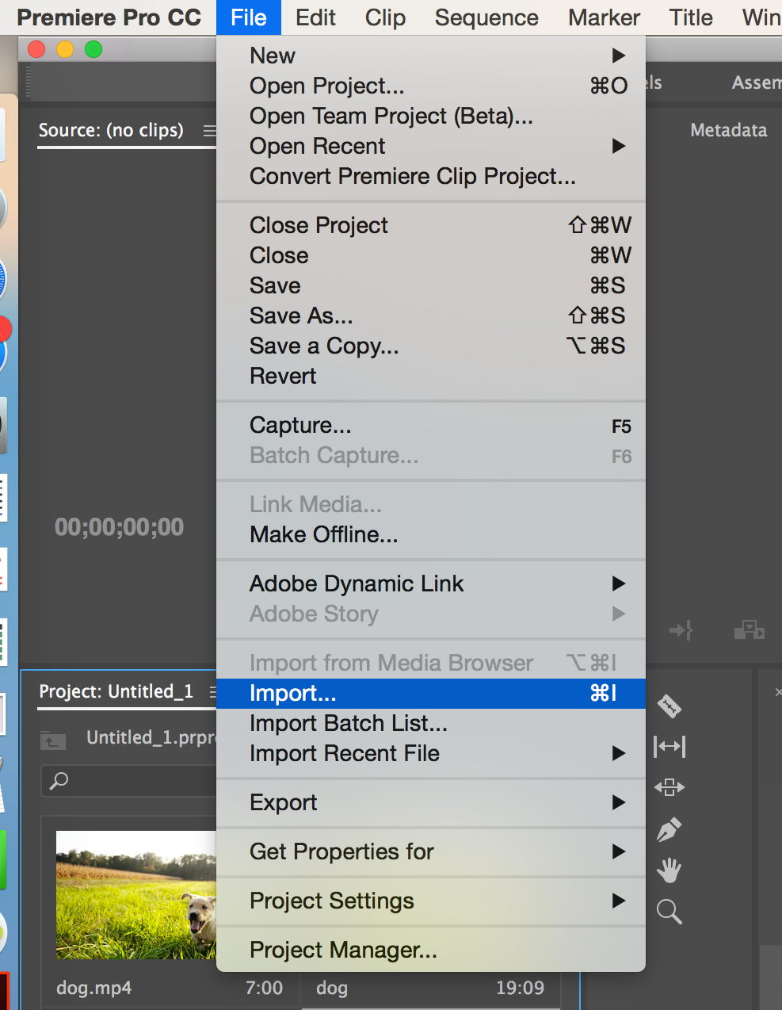
Import Command
Choose File > Import.
Select one or more files from the list of files.
Files will be added to the Project panel.
You may select an entire folder, which is added as a new bin in the Project panel.

Slide 5
Organize Video Clips
Assembly Cut
First stage of editing, when the raw video clips from a production are arranged into the proper sequence inside the project’s timeline.
Rough Cut
Second stage of editing, when the video clips are edited down using the correct in and out points, and initial transitions or special effects are added.

Slide 6
Organize Video Clips
Final Cut
Third stage of editing, when all of the transitions, special effects, and other editing techniques are finished; step preceding rendering and exporting.
Nested Sequence
Embedding multiple sequences of edited clips into a master composition to ease the overall editing and compositing process.

Slide 7
Marking Clips
Setting a clip’s In and Out points.
In a typical workflow, you mark In and Out points for a clip in the Source Monitor.
You define the first frame you want to include in a sequence by marking that frame as the clip’s In point.
Then you define the last frame you want to include by marking it as the Out point.
You then drag the marked clip to the timeline.

Slide 8
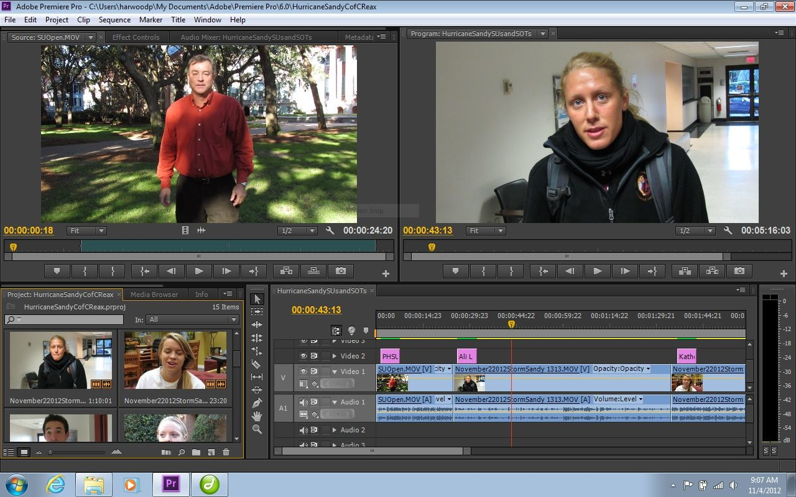
Marking Clips
Source Monitor
In Point Button
Out Point Button

Slide 9
Trimming Clips
Adjusting a clip's In and Out points after it is already edited into a sequence is called trimming.
You can trim clips by dragging the edge of a clip in the timeline.
Clip In Point in Timeline View

Slide 10
Advanced Audio Terms
Natural Sound (Room Tone)
Using the actual sounds of the environment in which the video takes place.
Typically used to make the video seem more realistic.
Recorded Narration (Voiceover)
Dialogue added to a video production to explain the visual scenario and give the audience more information about what is happening in the video.

Slide 11
Editing Audio in Video Editor
When you add a video clip to the timeline, the video and audio appear as two objects, each in its own track.
The video and audio portions of the clip are linked so that when you drag the video portion, the linked audio moves with it, and vice versa.
When you want to work with the audio and video individually, you can unlink them. This allows you to delete or edit them separately.

Slide 12
Editing Audio in Video Editor
Linked Audio Layer

Slide 13
Layering Audio in Video Editor
Audio layers can be used to add music, narration and sound effects.
Audio editing for video works in much the same way as when using an audio editor.
When making audio adjustments of any kind, determine whether the change is applied to the entire track or to individual clips. Audio tracks and clips are edited in different ways.

Slide 14
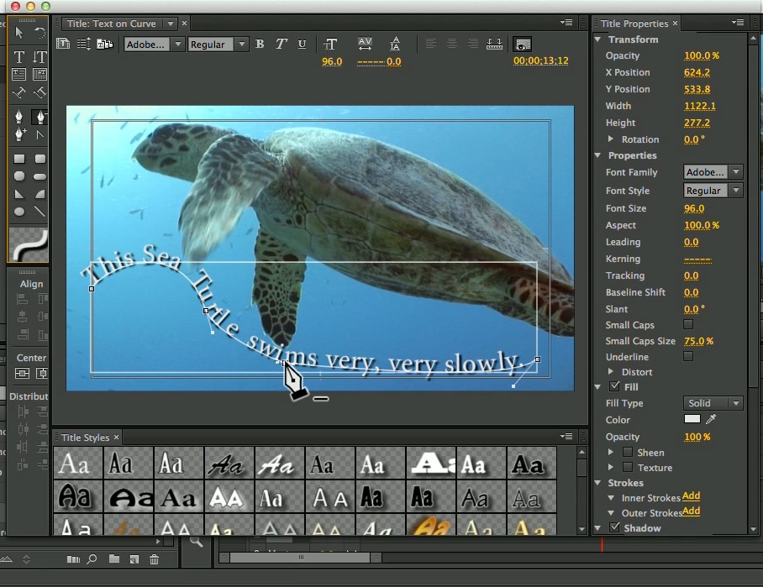
Video Titles
The Titler is a versatile tool enabling you to create not just titles and credits, but animated graphics and text as well.
Titles may be placed over video, still images or in separate frames.

Slide 15
Still Title
A title (block of text with or without an accompanying graphic) that appears on the screen, remains motionless, and then disappears.

Slide 16
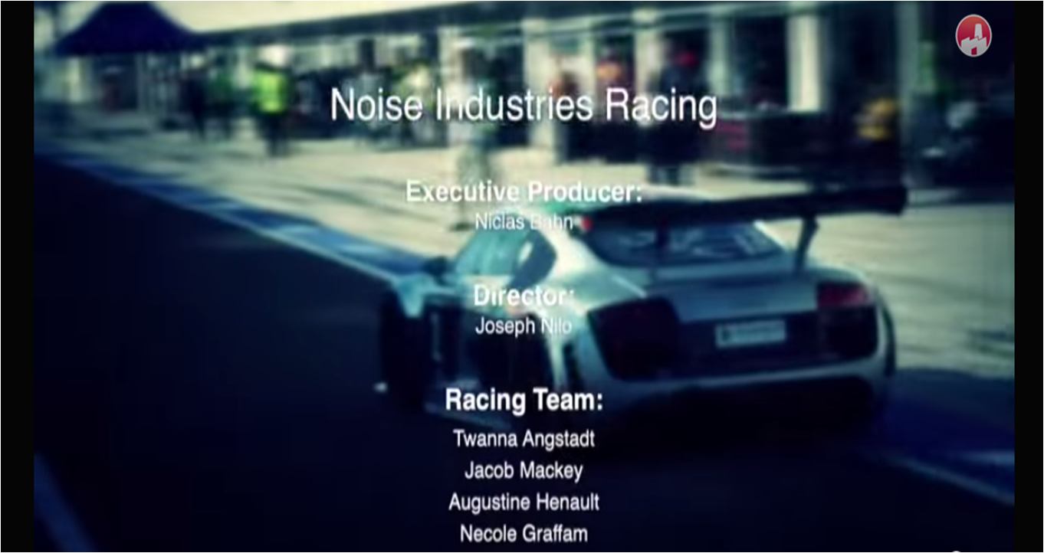
Roll Title
Appears from either the top or the bottom and moves vertically through the field of view and off the other side.

Slide 17
Crawl Title
Appears from either the left or the right and moves horizontally through the field of view and off the other side.

Slide 18
Superimposition Title
(Super or Lower Third) A title that relays information (their name, position or title, statistics, etc.) usually appears in the lower third of the screen.

Slide 19
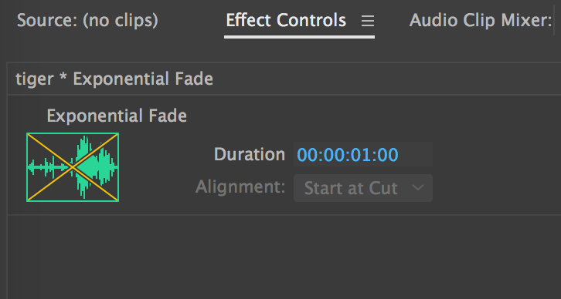
Video Transitions
Changing from one video clip to another in a video production.
Four basic types of transitions:
Cut
Dissolve
Fade Up or Fade Down
Wipe

Slide 20
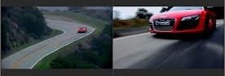
Cut
An instantaneous transition from one video clip to the next.

Slide 21
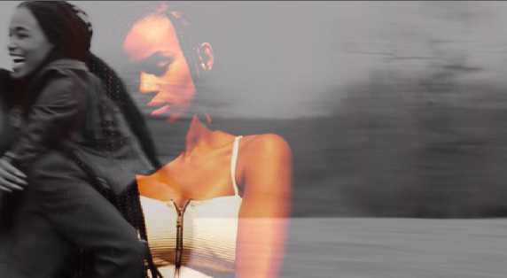
Dissolve
A gradual blend between one video clip and another.

Slide 22
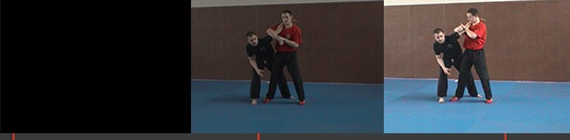
Fade Up or Fade Down
When the screen goes gradually from black or white to a video clip, or gradually from a video clip to a black or white screen.

Slide 23
Wipe
When one video clip replaces another by traveling from one side of the frame to the other or through a shape.

Slide 24
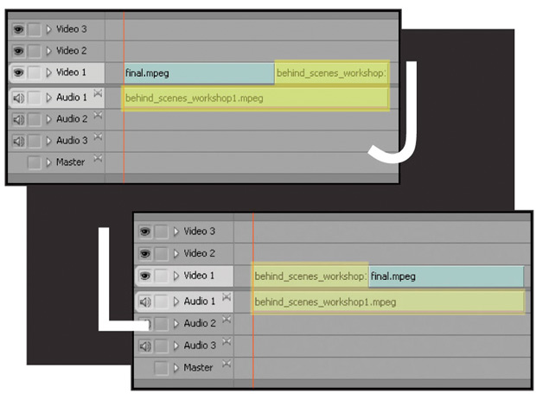
J-Cut/L-Cut
A J-Cut is when you hear audio from a shot and then see the video. You make the letter J visually in the timeline.
An L-Cut is when you cut to different video but the audio from that previous shot remains.

Slide 25
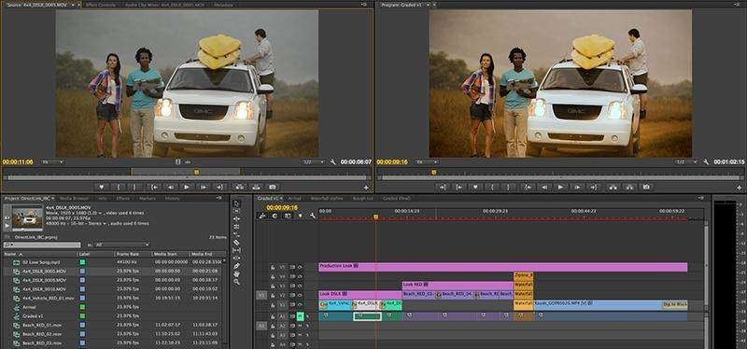
Compositing
Combining several layers of video and/or image sources together to create a final composition.

Slide 26
Masking
Similar to masking in graphics and animation; showing or hiding specific area(s) of a video clip.

Slide 27
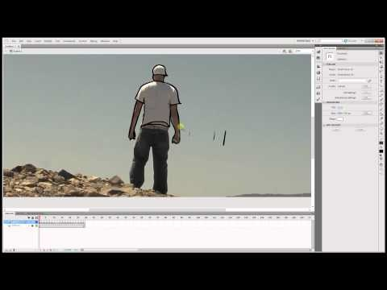
Rotoscoping
Masking an object in a video as it moves within the field of view.

Slide 28
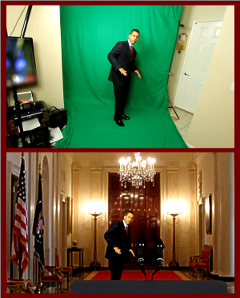
Chroma Keying/Ultra Key
(Green-Screen) Recording a video clip in front of a solid color background, then using a video editor to replace the background with another one.

Slide 29
Video Effects
There are a variety of effects that can be applied to video. Many can be used with anchor points to animate the effects occurrence.
Effect groups include:
Blur and Sharpen Effects
Color Correction Effects
Distort Effects
Image Control Effects

Slide 30
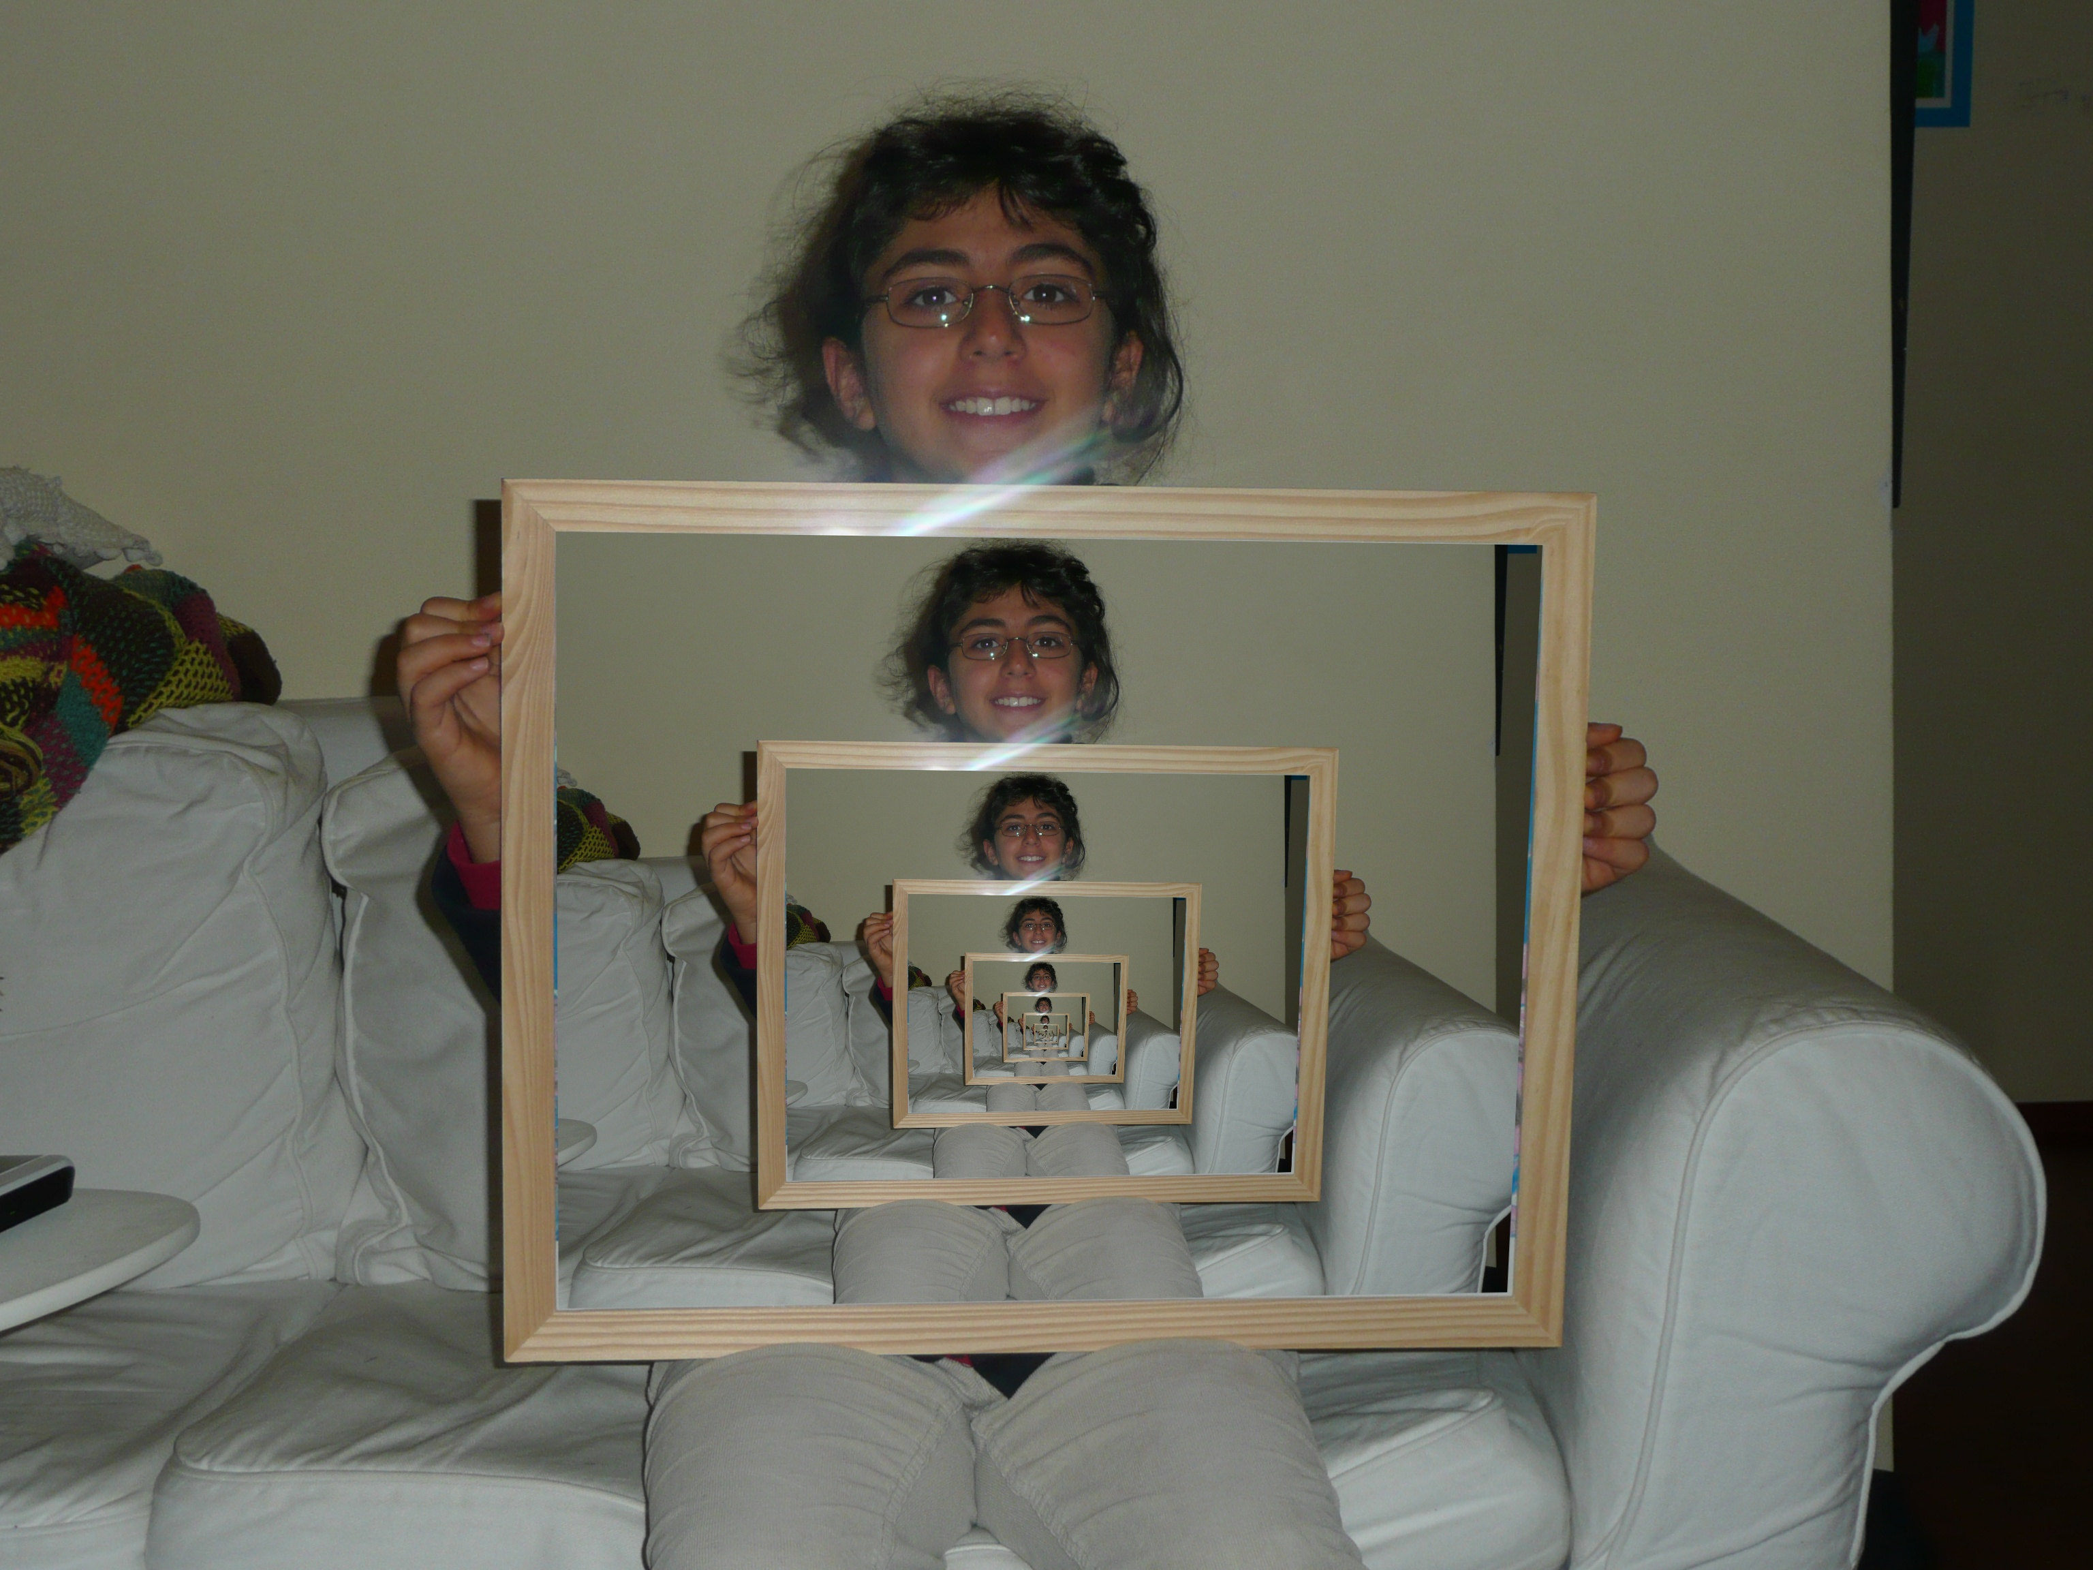
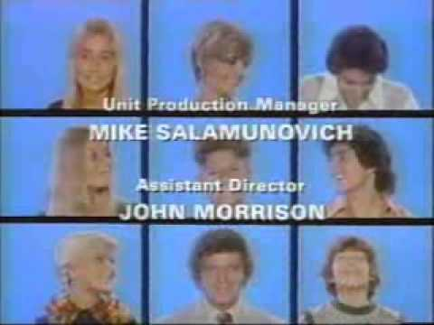
Layering Video
You can place one video clip in a small frame over a background video clip that covers the entire screen. This effect is called a picture-in-picture overlay.
By scaling video clips and layering multiple clips you can create the “Brady Bunch” effect.

