Slide 1
5.00 Apply procedures to export a video with Adobe Premiere Pro. (10%)

Slide 2
Optimize Video
Optimize based on specific client needs:
File Format Requirements
Video files also use codecs.
File Size Requirements
File Name Requirements

Slide 3
Common Video File Formats
.MOV
Uses the Quicktime player for video playback.
Standard video format for Apple computers.
.AVI
Standard video format for Microsoft PCs .
.WMV
Uses the Windows Media Player for video playback.
Microsoft file format used for streaming on the Internet.

Slide 4
Common Video File Formats
.FLV
Uses the Adobe Flash Player for video playback.
Commonly used for embedding videos on the Internet.
.MPEG-2
Format used for DVDs.
.MPEG-4
Format used for Blu-Ray Discs (better quality than MPEG-2).
Standard for streaming videos over the Internet.

Slide 5
Export Video
To export a video in Premiere Pro go to File>Export>Media. This will bring up your export settings window,
Choose format, file name and other settings.
May export entire or selected sequence, audio or video.
Make sure your sequence that you want to export is selected when you do this.

Slide 6
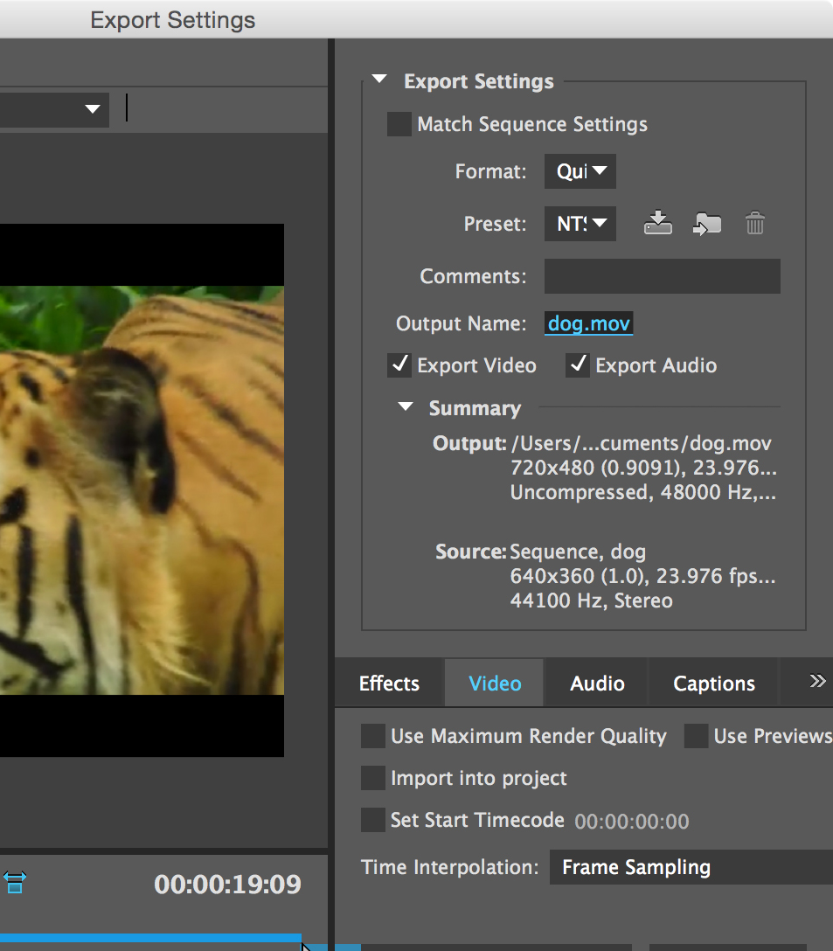
Export Settings
Format Options
File Save As Options
Other Options

