Slide 1
Adobe Visual Design 3.00 Understanding Adobe Photoshop (8%)

Slide 2
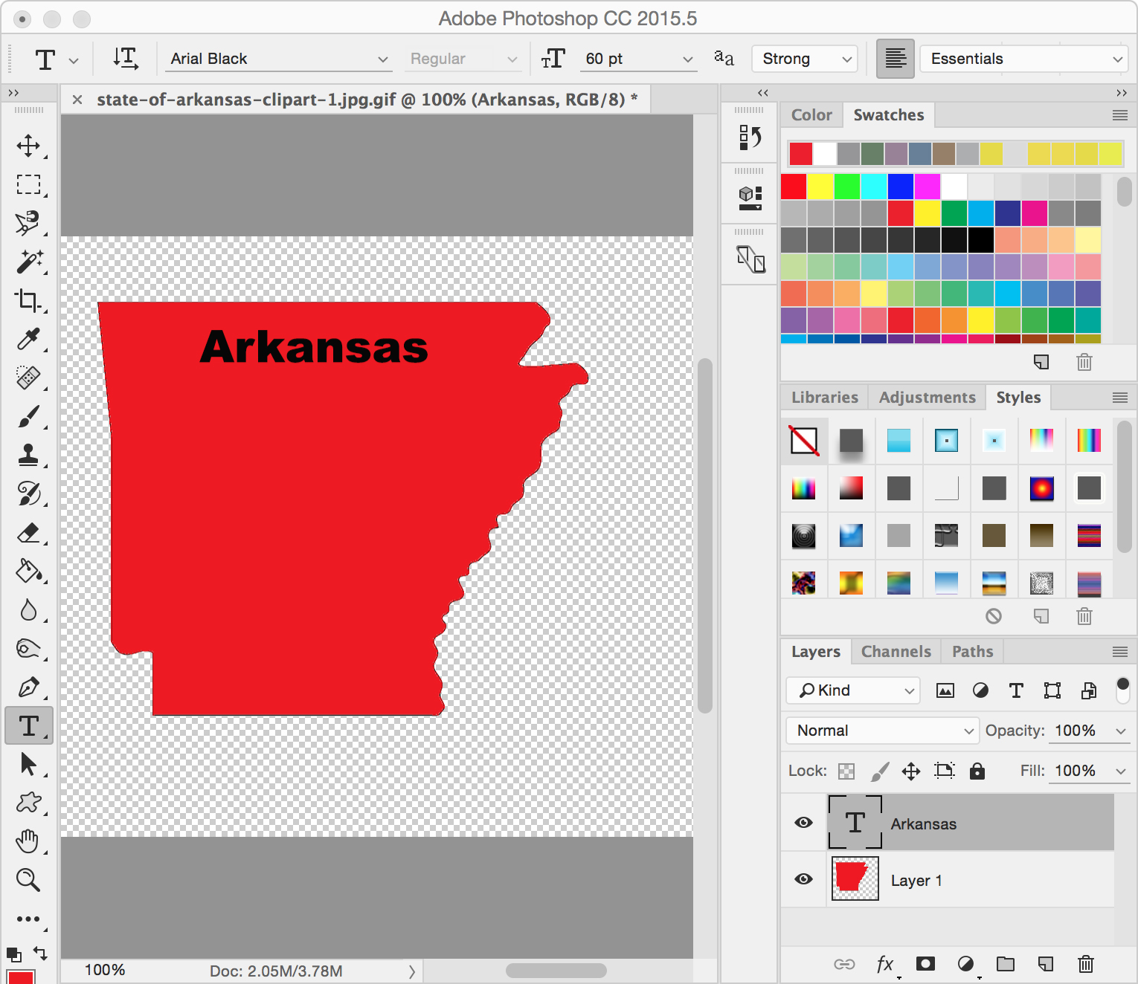
PhotoShop Interface

Slide 3
Panels in PhotoShop Workspace
Options Bar Control Panel
Document Panel
Tools Panel
History Panel
Color Panel
Layers Panel

Slide 4
Options Bar Control Panel
Displays options for the currently selected tool.
Options Bar with Type tool selected
Options Bar with Paint Bucket tool selected

Slide 5
Document Panel
Displays the file you’re working on.
Multiple graphic files can be opened and worked on.

Slide 6
Tools Panel
Contains tools for creating and editing images, artwork, page elements.
Related tools are grouped together.
A small triangle at the lower right of the tool icon signals the presence of hidden tools

Slide 7
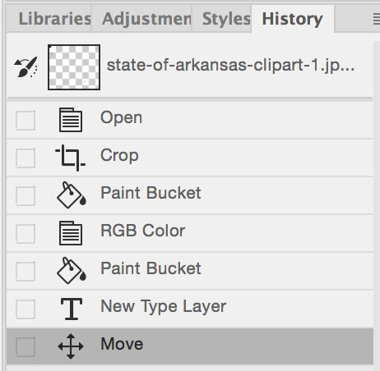
History Panel
Each time you apply a change to an image, the new state of that image is added to the panel.
Jump to any recent state of the image created during the current working session.

Slide 8
Color Panel
Displays the color values for the current foreground and background colors.
Using the sliders, you can edit the foreground and background colors using different color models.

Slide 9
Layers Panel
Lists all layers, layer groups, and layer effects in an image.
You can use to show and hide layers, create new layers, and work with groups of layers.

Slide 10
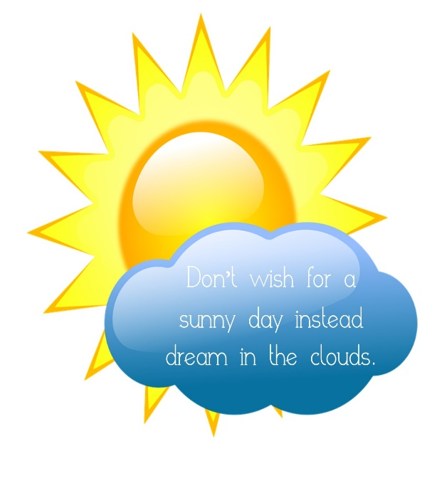
Stacking Order
By default, a new image is stacked to the front.
The stacking order can be changed by moving the layer in the Layers Panel.
Or by using Arrange and:
Send to Back
Send Backward
Send to Front
Send Forward

Slide 11
Photo Manipulation Terms
Destructive vs. Non-Destructive Editing
Destructive editing changes the original photo in a way that cannot be reversed after saving and closing; non-destructive editing makes changes to the original photo that can always be reversed.
Retouching
Removing unwanted elements and/or blemishes from a photo to enhance the visual quality.

Slide 12
Photo Manipulation Terms
Adjusting Levels
Changing highlights, shadows, and mid-tones of a photo.
Exposure
The amount of light in a photo; under-exposed is not enough light, while over-exposed is too much light.
Sharpness
The property of a photo that describes the clarity of detail.

Slide 13
Photo Manipulation Terms
Contrast
The amount of separation between the darkest areas of a photo and the brightest areas; adding contrast causes a photo to look more defined.
Smart Object
Converting a photo or graphic to a smart object allows it to be scaled, rotated, or warped without losing the original quality.

Slide 14
Color Terms
Color Correction
Adjusting the color values of a graphic to make them appear more realistic or to meet the desired effect (ex: red eye correction or changing tint).
Color Profile
A pre-determined subset of specific colors assigned to an image; preset for devices like scanners, digital cameras, monitors, and printers so that the color of an image remains true from source to destination.

Slide 15
Color Terms
Color Gamut
The range of colors that is defined by the color profile; when working within a given color profile, color choices are selected from the gamut.
Dithering
If a particular output device (monitor, web page, etc.) cannot display colors within the assigned color profile, a process called dithering peppers in pixels of similar colors to replace the colors that cannot be displayed.

