Slide 1
Adobe Visual Design 4.00 Apply procedures to manipulate images using Adobe Photoshop (17%)

Slide 2
Graphic Editing Terms
Cropping
Eliminating unwanted parts of a graphic.
Scaling
Changing a graphic’s size dimensions (height and width).
Layering
Separating components of a design individually or into groups in order to make adjustments specific to the layer.

Slide 3
Graphic Editing Terms
Selection
Surrounding specific part(s) of a graphic to make individual adjustments.
Feathering/Blending
smoothing or blurring the edges of an image to help transition into the background or into another image.

Slide 4
Graphic Editing Terms
Grids and Rulers
Measuring tools used to assist in the scaling, arranging, and spacing of design components.
Gradient
A gradual change of color within a design component.

Slide 5
Graphic Editing Terms
Filters
Preset effects applied to entire graphic used to quickly adjust a graphic’s appearance.
Layer Styles
Preset effects applied to graphics and/or text within a layer that add depth and dimension.

Slide 6
Fill and Stroke
Stroke is the outline of a shape, text or image.
Weight
Color
Style
Fill is the inside color of a closed shape.

Slide 7
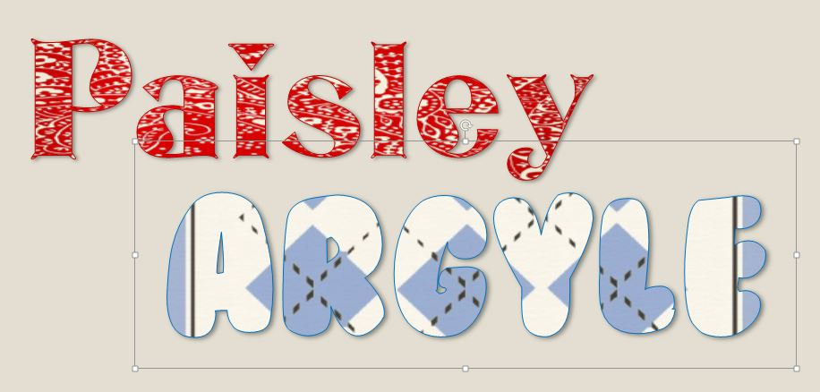
Patterns
A repeating pattern fills the image with a unique assortment of shapes and colors.

Slide 8
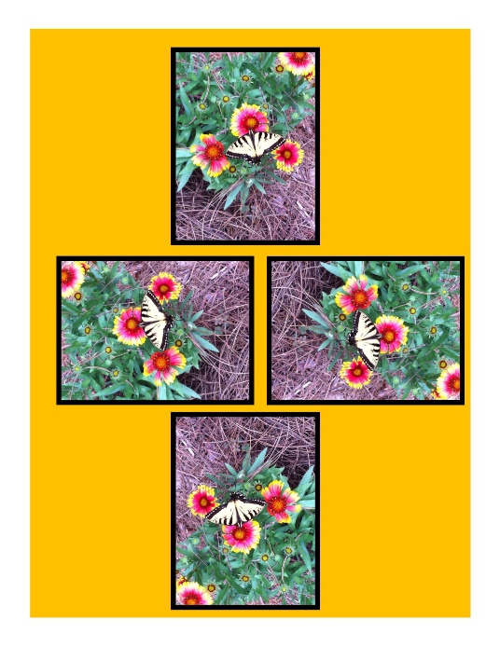
Free Transform
Change by using rotate, scale, skew, distort, or perspective in one continuous operation. Instead of choosing different commands, you simply hold down a key on your keyboard to switch between transformation types.
Rotating an object turns it around a fixed point that you choose.
Hold Shift while resizing to keep the proportions or use Scale instead.

Slide 9
Straighten Tool
In the crop tool, you can straighten the image.
Choose Straighten Tool by clicking on its icon in the Options Bar or press CTRL/CMD while the crop tool is active.

Slide 10
Selection Tools
Allows you to choose a specific part of the image. There are several selection tools each work in a different way.
Marquee
Lasso
Quick Selection Tool
Magic Wand

Slide 11
Marquee Selection
Selects in the shape specified. The marquee shows the following options:
Rectangle
Elliptical
Single Row
Single Column

Slide 12
Lasso Selection
Three versions of lasso selection tool all enable a free-hand draw around image to be selected.
Lasso
Lasso tool is great for drawing freeform segments of a selection border.
Polygonal Lasso
The polygonal lasso is best for straight-edged segments of a selection border.
Magnetic Lasso
The magnetic lasso tool snaps to the edges of defined areas (color) in the image.

Slide 13
Other Selection Tools
Quick Selection
Use the quick selection tool to quickly “paint” a selection using a round brush tip.
Magic Wand
The magic wand will allow you to make selections by color, pattern and stroke weight.

Slide 14
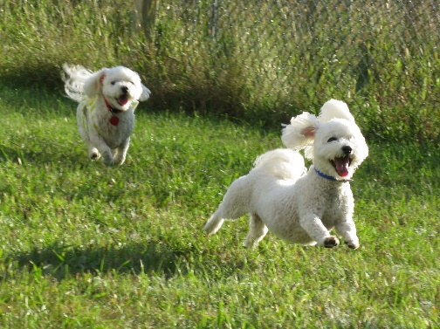
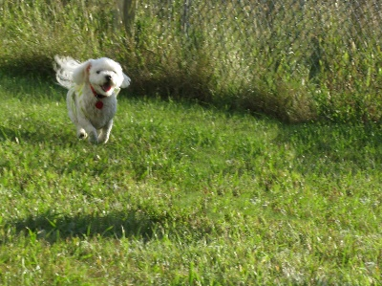
Spot Healing Brush Options
Content Aware
This allows you to replace unwanted parts of the image with pixels near it.
The magic of Content Aware is how it automatically samples the pixels around it to fill in what you want to recolor.

Slide 15
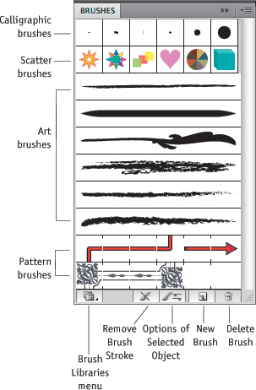
Brush Tool
Apply and draw with brushes to create artistic elements.
Many options in options bar for brushes.

Slide 16
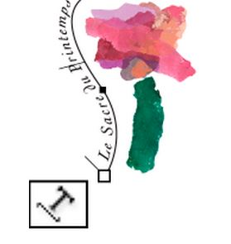
Type on a Path
The text flows along an open or closed path.
Horizontally, the characters are parallel to the baseline.
Vertically, the characters are perpendicular to the baseline.

