Slide 1
Adobe Visual Design 5.00 Apply procedures to publish digital images using Adobe Photoshop (2%) 10.00 Apply procedures to publish illustrations using Adobe Illustrator (1%)

Slide 2
Publish Graphics
Optimize the graphic for specific client needs, including :
File format requirements
File size requirements
File name requirements

Slide 3
Optimize for Web
Use Export/Save for Web command.
Save in web friendly format for faster download, i.e.
JPEG
GIF
PNG
PDF
Adjust file quality and compression.
For working purposes, incorporate some of the settings into the filename, such as “banner_medium.jpg” for an image saved as a medium-quality JPEG.

Slide 4
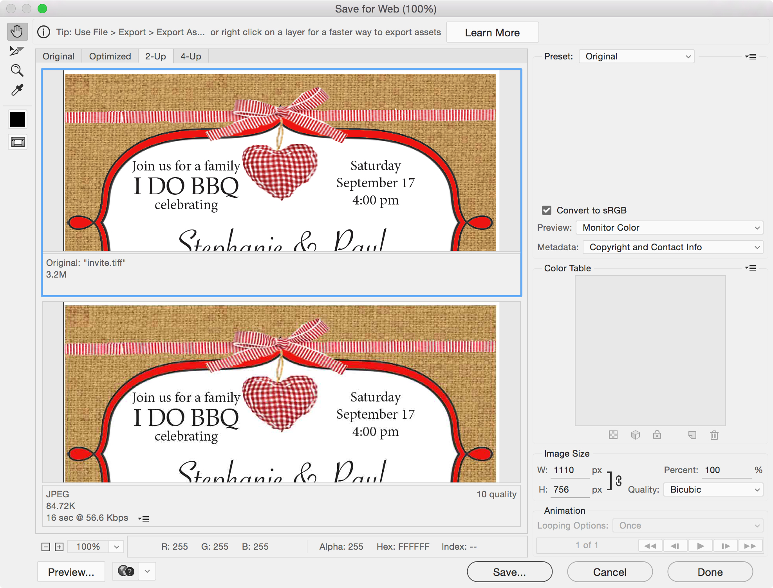
Optimize for Web

Slide 5
Generate for Print
Set image resolution to 300 ppi for better quality.
Convert to CMYK (if sending to offset printer)
Use lossless or un-compressed format.

Slide 6
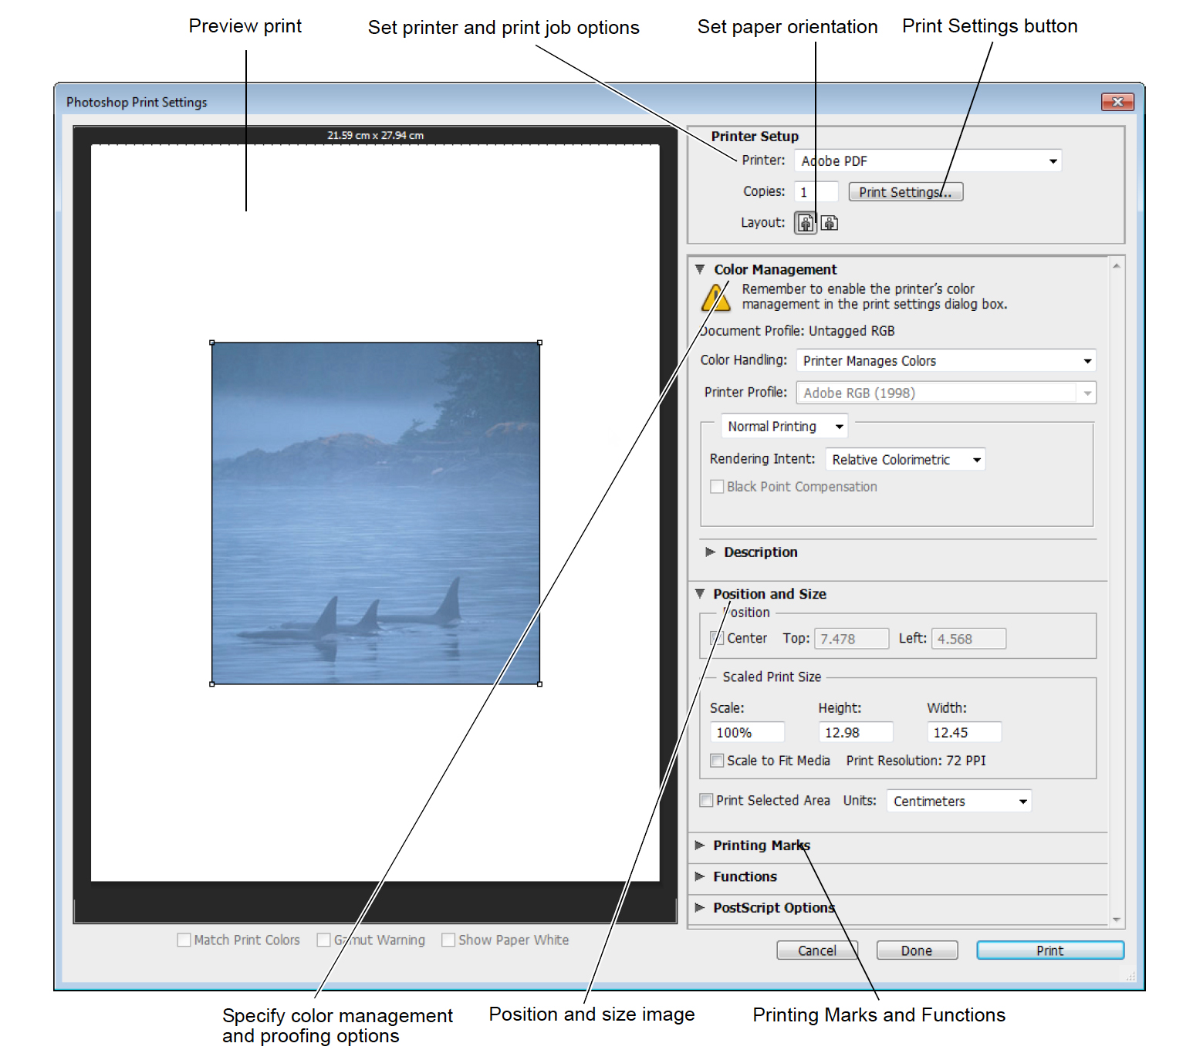
Adjust Print Settings

Slide 7
Images for Video
Create images of various aspect ratios so that they appear properly on video devices.
Using the options in the Size menu, you can produce images for specific video systems—NTSC, PAL, or HDTV.
Use safe zones to ensure that everything fits within the area that most TVs display, keep text within the title-safe margins, and all other important elements within the action-safe margins.

Slide 8
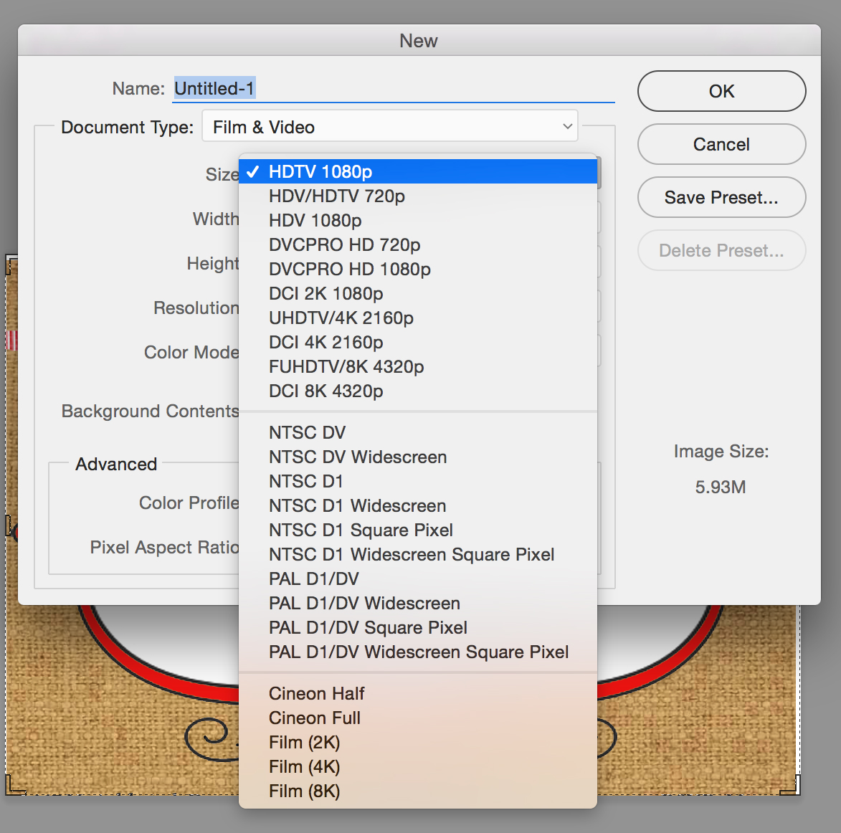
Adjust Video Settings
Create a new document.
Choose Film & Video preset.
Choose appropriate size option.

