Slide 1
Adobe Visual Design 8.00 Understanding Adobe Illustrator interface (2%)

Slide 2
Illustrator Interface

Slide 3
Panels in Illustrator Workspace
Workspace is same as PhotoShop with a few new tools and panels.
Options Bar Control Panel
Document Panel
Tools Panel
History Panel
Color Panel
Layers Panel

Slide 4
Tools Panel
Tools grouped and hidden similar to PhotoShop.
Note new Illustrator tools.

Slide 5
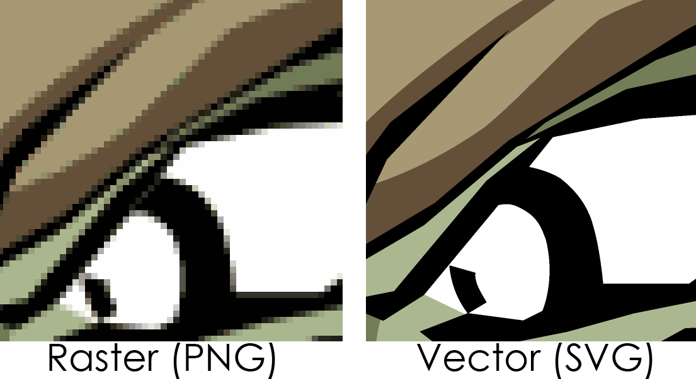
Vector Images
Use mathematic equations and geometric elements (points, lines, and shapes) to create art.
Can be scaled infinitely, without any loss of quality or fidelity.
Watch this video:
https://helpx.adobe.com/illustrator/how-to/what-is-illustrator.html?set=illustrator--get-started-

Slide 6
Vector Formats
Vector art is usually created in Adobe Illustrator.
The four most common Vector file extensions are:
.ai – Adobe Illustrator
.pdf – Portable Document Format
.eps -Encapsulated Postscript
.svg – Scaled Vector Graphics

Slide 7
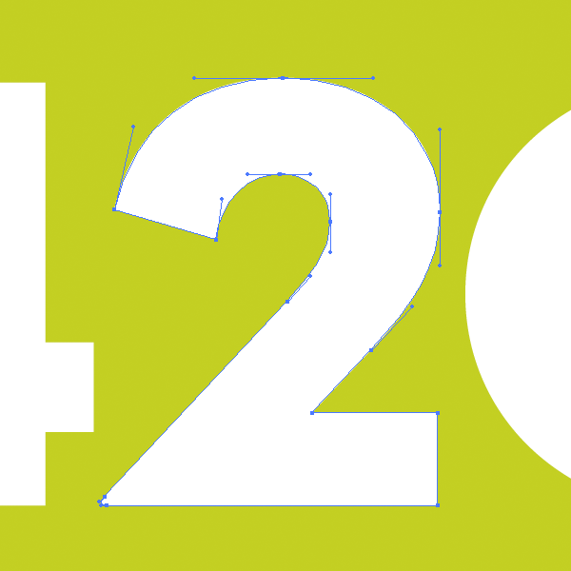
Is it a Vector?
Just because a file is saved in one of these formats, does not mean that it is truly vector art.
Check to make sure that it was created as vector art.
In vector editing program, open your art file, and use the selection tool on an area within the art. You should see the vector editing nodes.

