Slide 1
Adobe Visual Design 9.00 Apply procedures to create illustrations using Adobe Illustrator (10%)

Slide 2
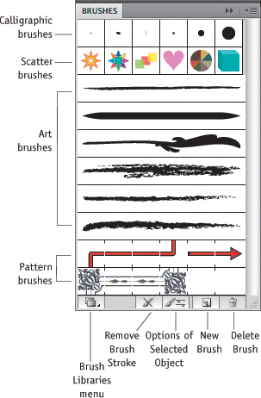
Brush Tool
Apply and draw with brushes to create artistic elements.
Many options in options bar for brushes.

Slide 3
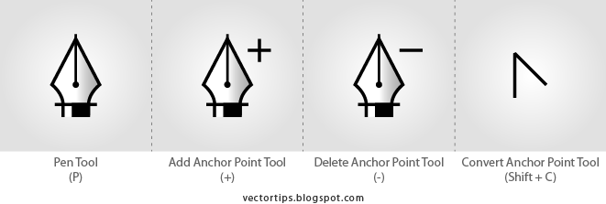
Pen Tool
Use the pen tool to add and delete anchor points.

Slide 4
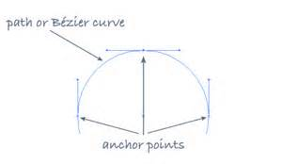
Anchor Point
A point on a path that indicates a change of direction.
You can add anchor points or delete anchor points to change the shape of a path.

Slide 5
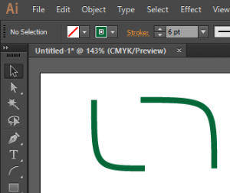
Arc Tool
The arc tool is used to create curved lines.
Drag the line around to curve at different arrows.
Press up and down arrows to increase and decrease height of angles.

Slide 6
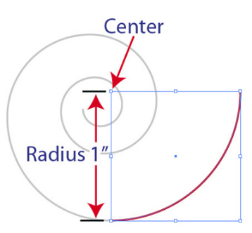
Spiral
You can adjust a spiral’s shape by:
Radius (distance from the center to the outermost point)
Decay percentage (amount the wind decreases)
Number of segments
Style options

Slide 7
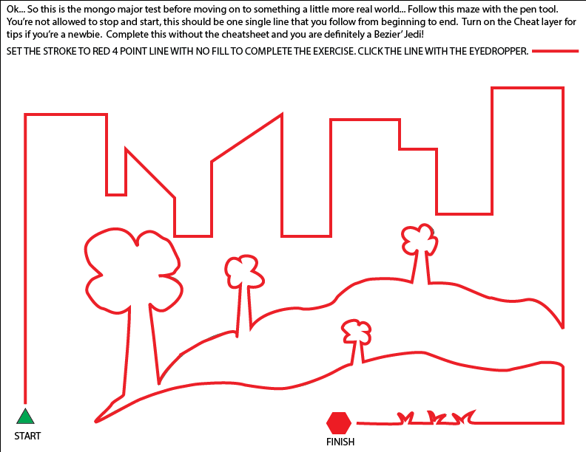
Paths
Open Path
Open paths do not end. They don’t connect back to the original anchor point.
Closed Path
A closed path has the same beginning and ending point.
It forms a complete shape than can be filled with color or text.

Slide 8
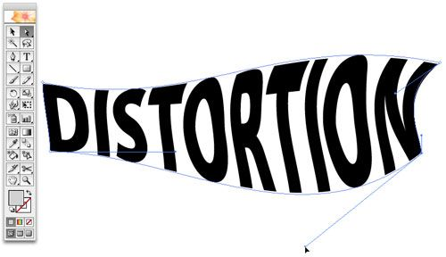
Shear
Shearing objects will slant or skew the object. This is great for casting shadows.
Distorting objects is best with the liquefy tool.

Slide 9
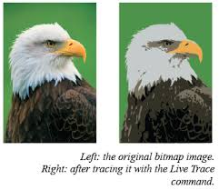
Image Trace
Use the Image Trace to automatically trace an image.

Slide 10
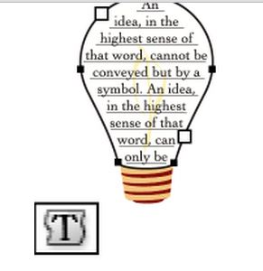
Area Type
In area type the text fills in a closed path.
Use this when you want text to appear inside a shape or object.

Slide 11
Point Type
Point type begins right where you click and does not automatically wrap to the next line.
In the example, the text began with Point Type. It does not wrap around to the next line. The text continues off the page indefinitely.

